Slide 1
String Comparison
Reference: http://www.catalysoft.com/articles/StrikeAMatch.html

Slide 2
Define Problem
Given 2 strings. Calculate their matching percent.
First String | Second String | Result (percent)
Healed | Sealed | 80
Healed | Healthy | 55
Healed | Healed | 44
Healed | Herded | 40
Healed | Help | 25
Healed | Sold | 0

Slide 3
Requirement
A robustness to changes of word order: two strings which contain the same words, but in a different order, should be recognised as being similar.
Language independence: the algorithm should work not only in English, but in many different languages.

Slide 4

Solution
Find out how many adjacent character pairs are contained in both strings.
$similarity\left(s1,s2\right)=\frac{2×\left|pairs(s1)∩pairs(s2)\right|}{\left|pairs\left(s1\right)\right|+\left|pairs(s2)\right|}$

Slide 5
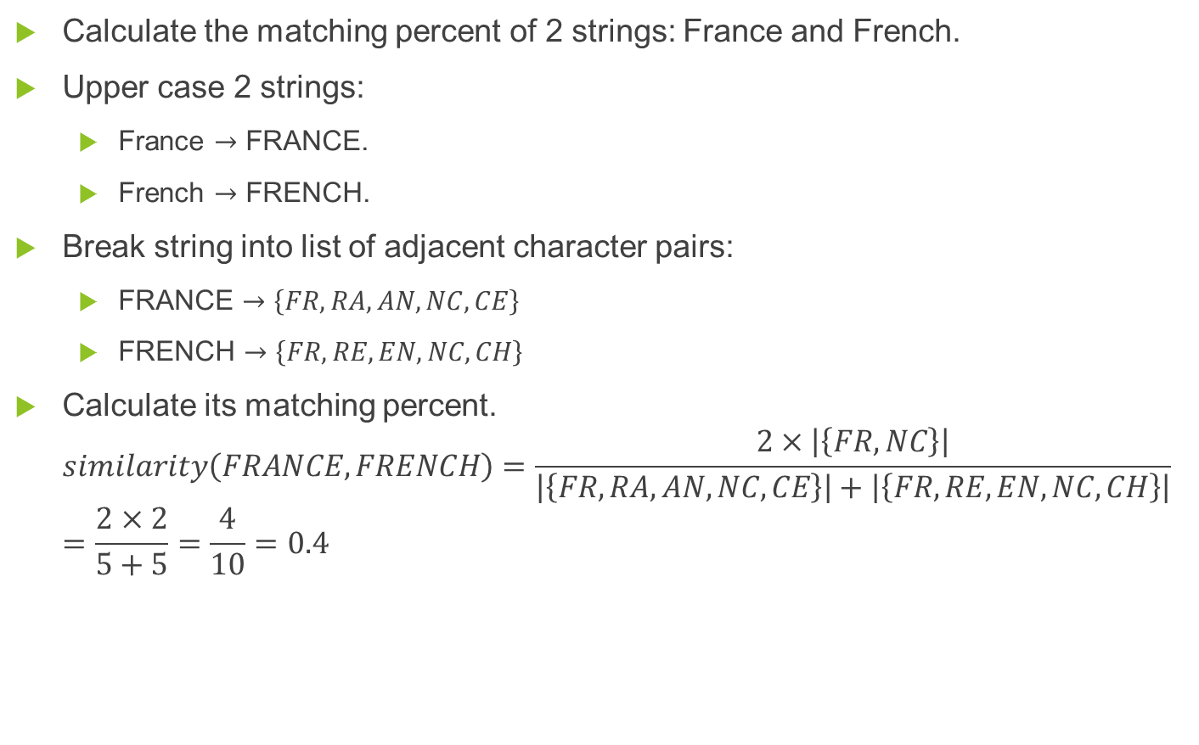
Example
Calculate the matching percent of 2 strings: France and French.
Upper case 2 strings:
France $→$ FRANCE.
French $→$ FRENCH.
Break string into list of adjacent character pairs:
FRANCE $→\left\{FR,RA,AN,NC,CE\right\}$
FRENCH $→\left\{FR,RE,EN,NC,CH\right\}$
Calculate its matching percent. $similarity\left(FRANCE,FRENCH\right)=\frac{2×\left|\left\{FR,NC\right\}\right|}{\left|\left\{FR,RA,AN,NC,CE\right\}\right|+\left|\left\{FR,RE,EN,NC,CH\right\}\right|}$ $=\frac{2×2}{5+5}=\frac{4}{10}=0.4$

